Slide 1

Problem Statement: 5. Loan Management System LoanSphere
Next-Gen Loan Management System
Secure, Scalable, and Smart Financial Processing
Presented By: Sharanya Velagandula January 07, 2026

Slide 2

Business Context
Banks, NBFCs, and financial institutions manage multiple loan products such as Personal Loans, Home Loans, Vehicle Loans, and Education Loans.
Common Challenges
Manual Processing: Manual or semi-automated loan processing.
Tracking Issues: Difficulty tracking loan status and approvals.
The Goal
"To build a Loan Management System that digitizes the complete loan lifecycle - from application to closure."
Limited Visibility: Limited visibility into EMI schedules and repayments.
Poor Audit: Poor audit and reporting mechanisms.
Security Risks: Security risks around customer financial data.

Slide 3

Project Overview
What it Does
The Loan Management System (LMS) is a robust enterprise-grade web application designed to streamline the entire loan lifecycle. It transforms traditional, paper-heavy lending processes into a seamless digital experience - from initial application to final closure.
High-Level Tech Stack
Frontend: Angular with Angular Material
Backend: ASP.NET Core Web API (.NET 9)
Database: SQL Server with Entity Framework Core
Security: JWT Authentication & Role-Based Access Control

Slide 4

The Solution: LoanSphere
A strictly digital, secure, and role-based lending platform.
Core Pillars
End-to-End Digitization:
Applied -> Under Review -> Active(Approved)/Rejected -> Closed
Smart Intelligence
Real-Time:
Instant notifications and dynamic dashboards.
Secure:
JWT Auth, RBAC, Bcrypt Passsword Hashing.
Role-Based Access:
Dedicated portals for Admin, Officers, and Customers.

Slide 5

Detailed Tech Stack & Implementation
FRONT END
BACK END
DATABASE & TOOLS
Angular (v20+) + Material Design
ASP.NET Core Web API (.NET 9)
SQL Server Database
Reactive Forms (Validation)
EF Core ORM (Code-First)
Swagger (OpenAPI) & Postman
Snackbars & Data Pipes
JWT Auth & Custom Role Logic
Git Version Control
Pagination, Search & Filter
LINQ & DTOs (No Entity Exposure)
Database Seeder (DbInitializer)
TypeScript Models & Interfaces
Repository Pattern / Layered Arch.
Global Exception Middleware

Slide 6

Key Features (The "Wow" Factor)
Workflow Engine ⚙
Enforces strict status transitions (Applied -> Under Review -> Approved(Active)/Rejected - > Closed).
Maker-Checker Principle 🛡
2-level approval process: Verifier (Officer 1) cannot be Approver (Officer 2).
Smart EMI Engine 💸
Auto-calculates amortization schedules and handles foreclosures.
Financial Tools 🧮
Integrated EMI and Foreclosure Calculators for transparency.
Moratorium Support 🎓
Education Loan: Repayment holiday during course + 6-12 months buffer.
Live Notifications 🔔
Instant alerts for status changes, EMI payments, and doc uploads.

Slide 7

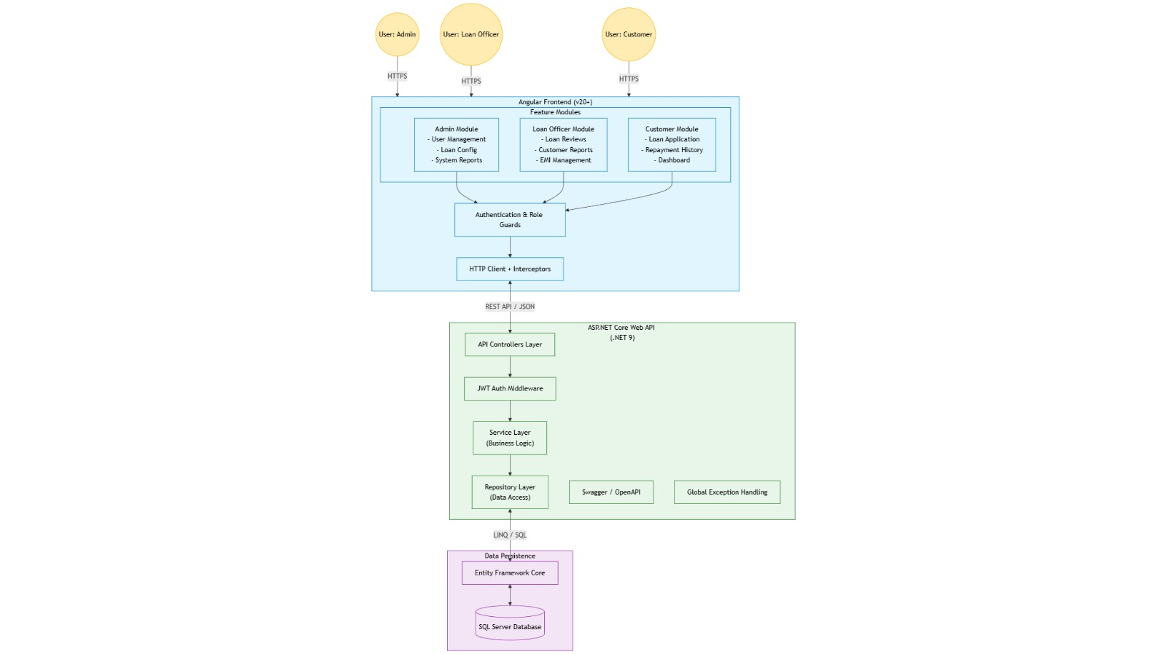
System Architecture

Slide 8
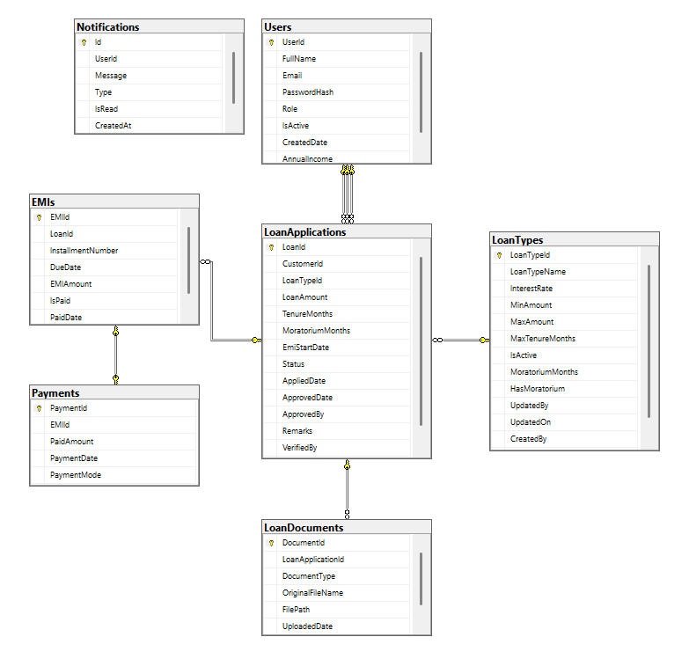
ER Diagram

Slide 9
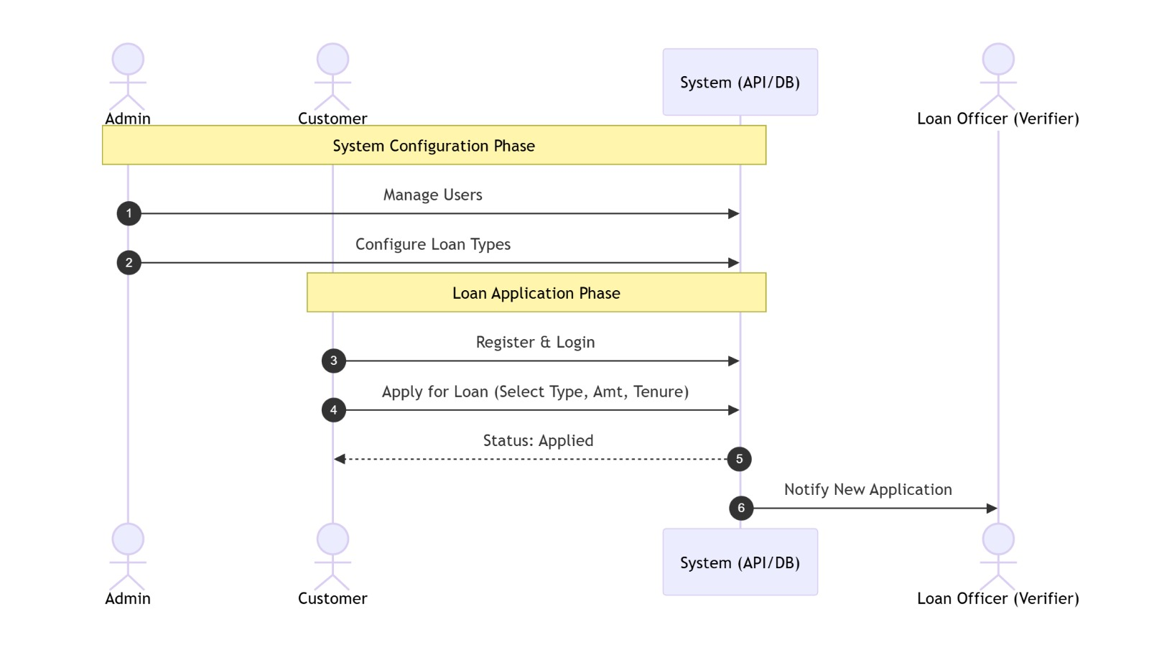
Work Flow

Slide 10
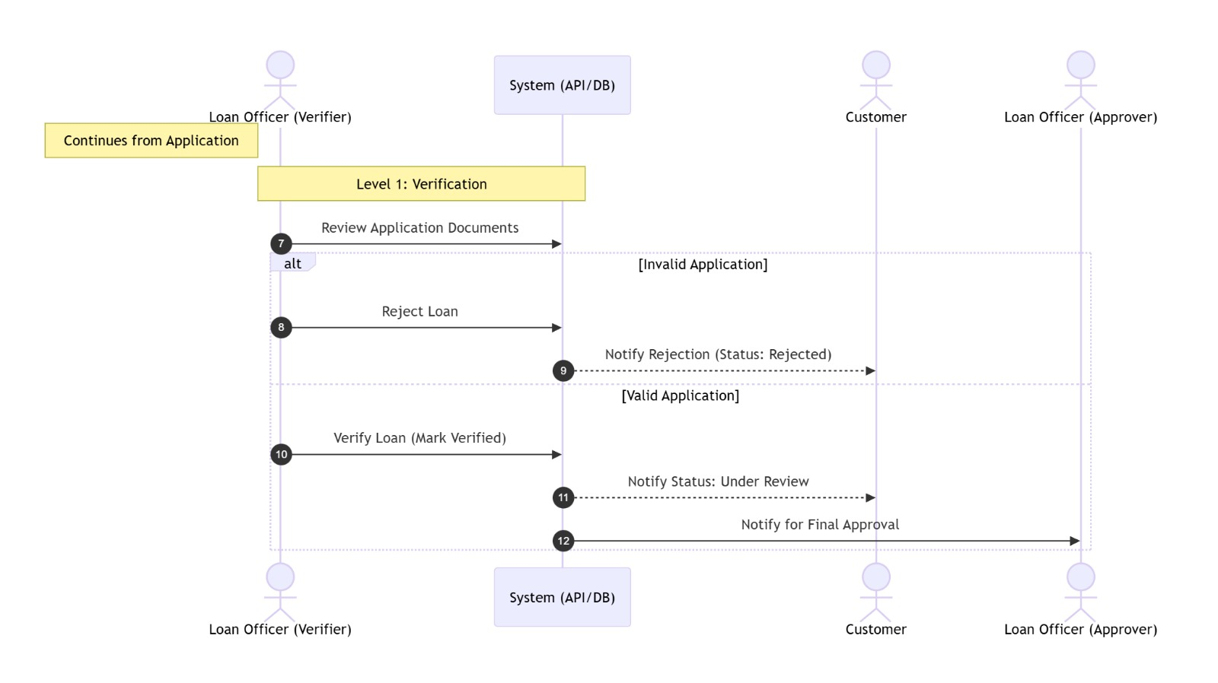
Work Flow

Slide 11
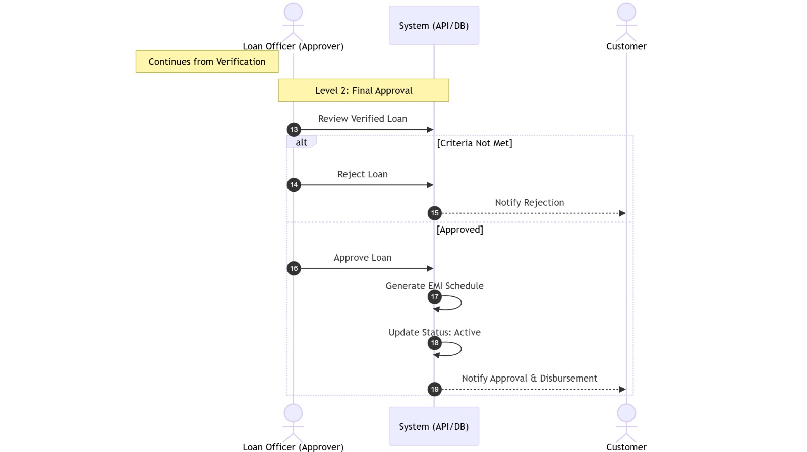
Work Flow

Slide 12
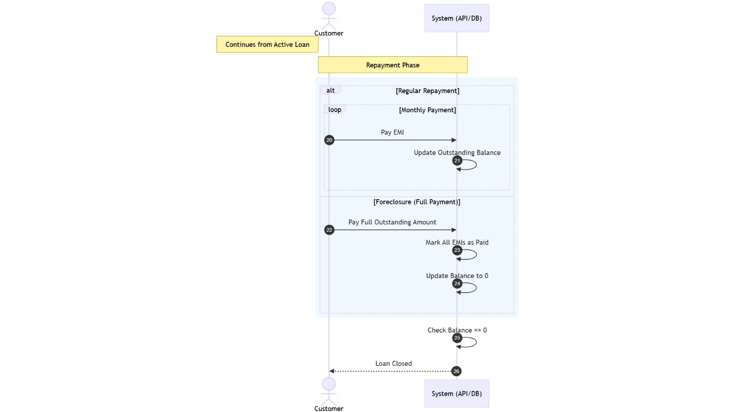
Work Flow

Slide 13
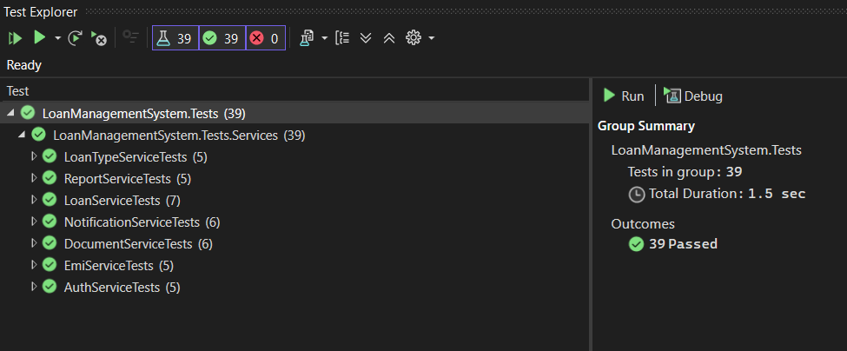
Testing

Slide 14

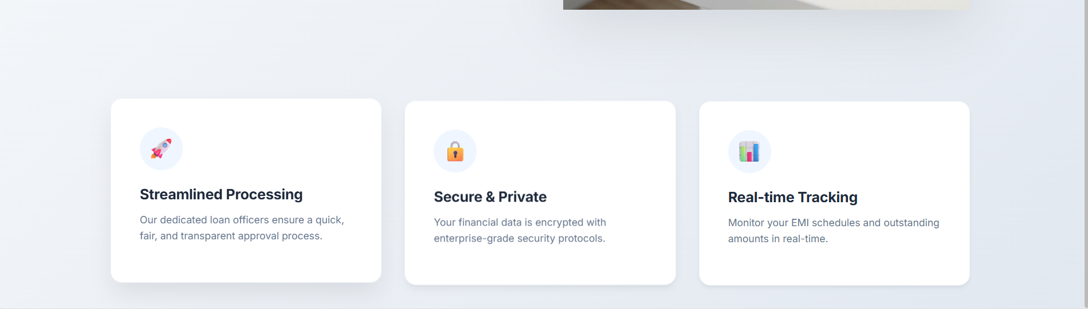
UI Screens
Home Page

Slide 15
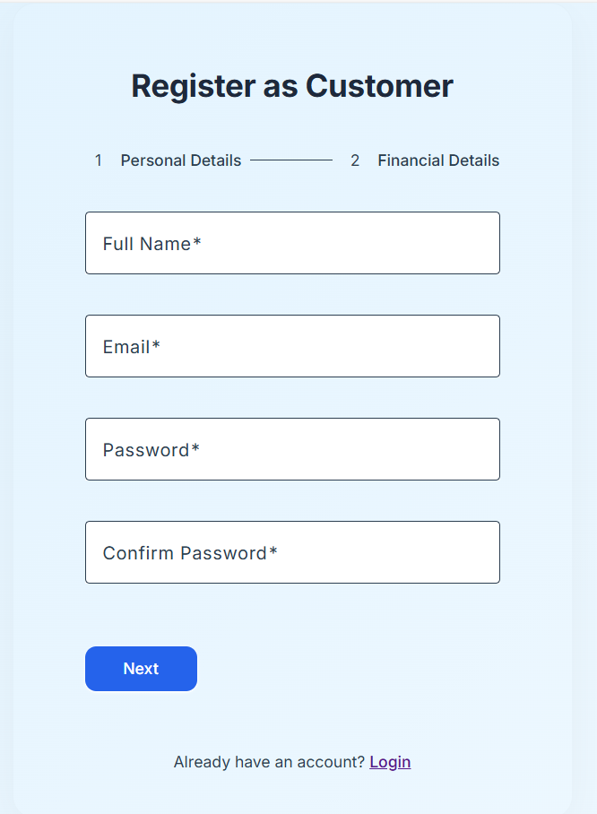
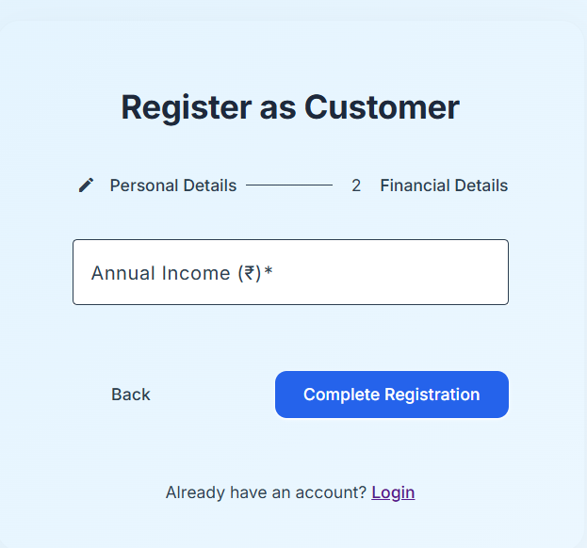
UI Screens
Customer Registration Page

Slide 16
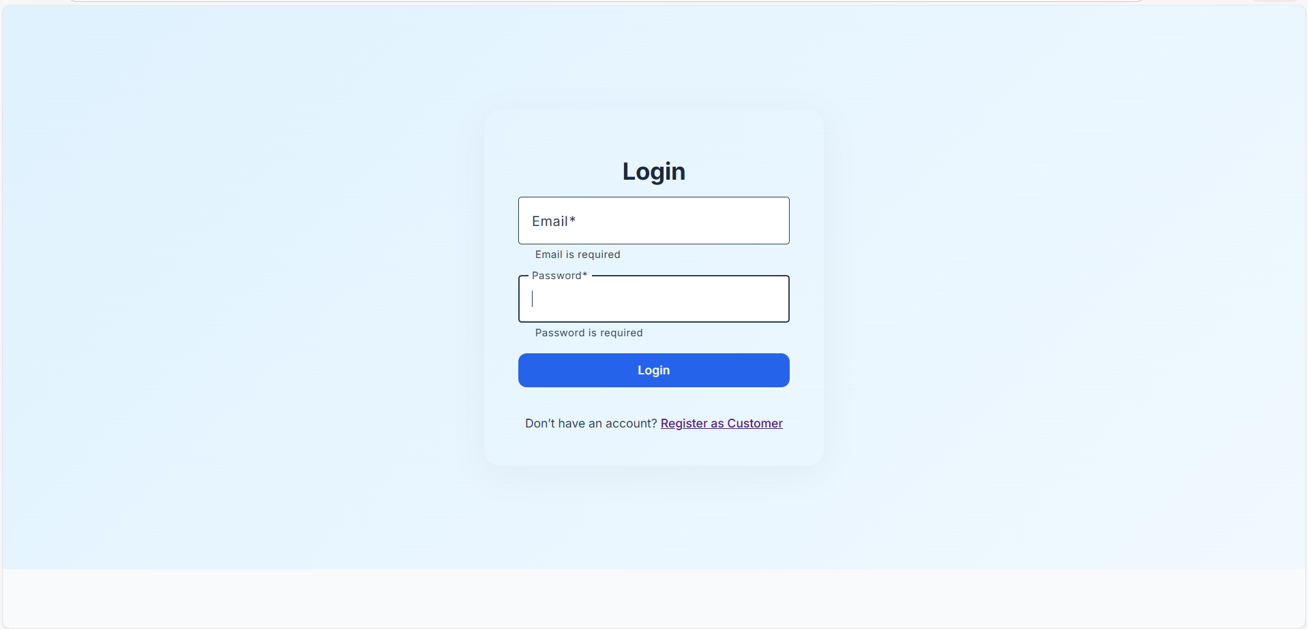
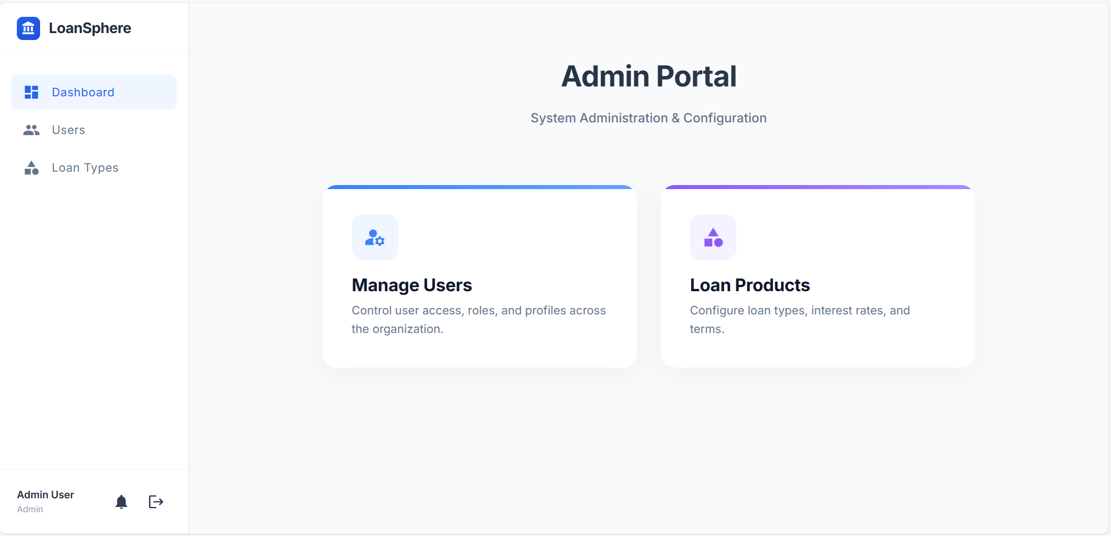
UI Screens
Login Page
Admin Dashboard

Slide 17
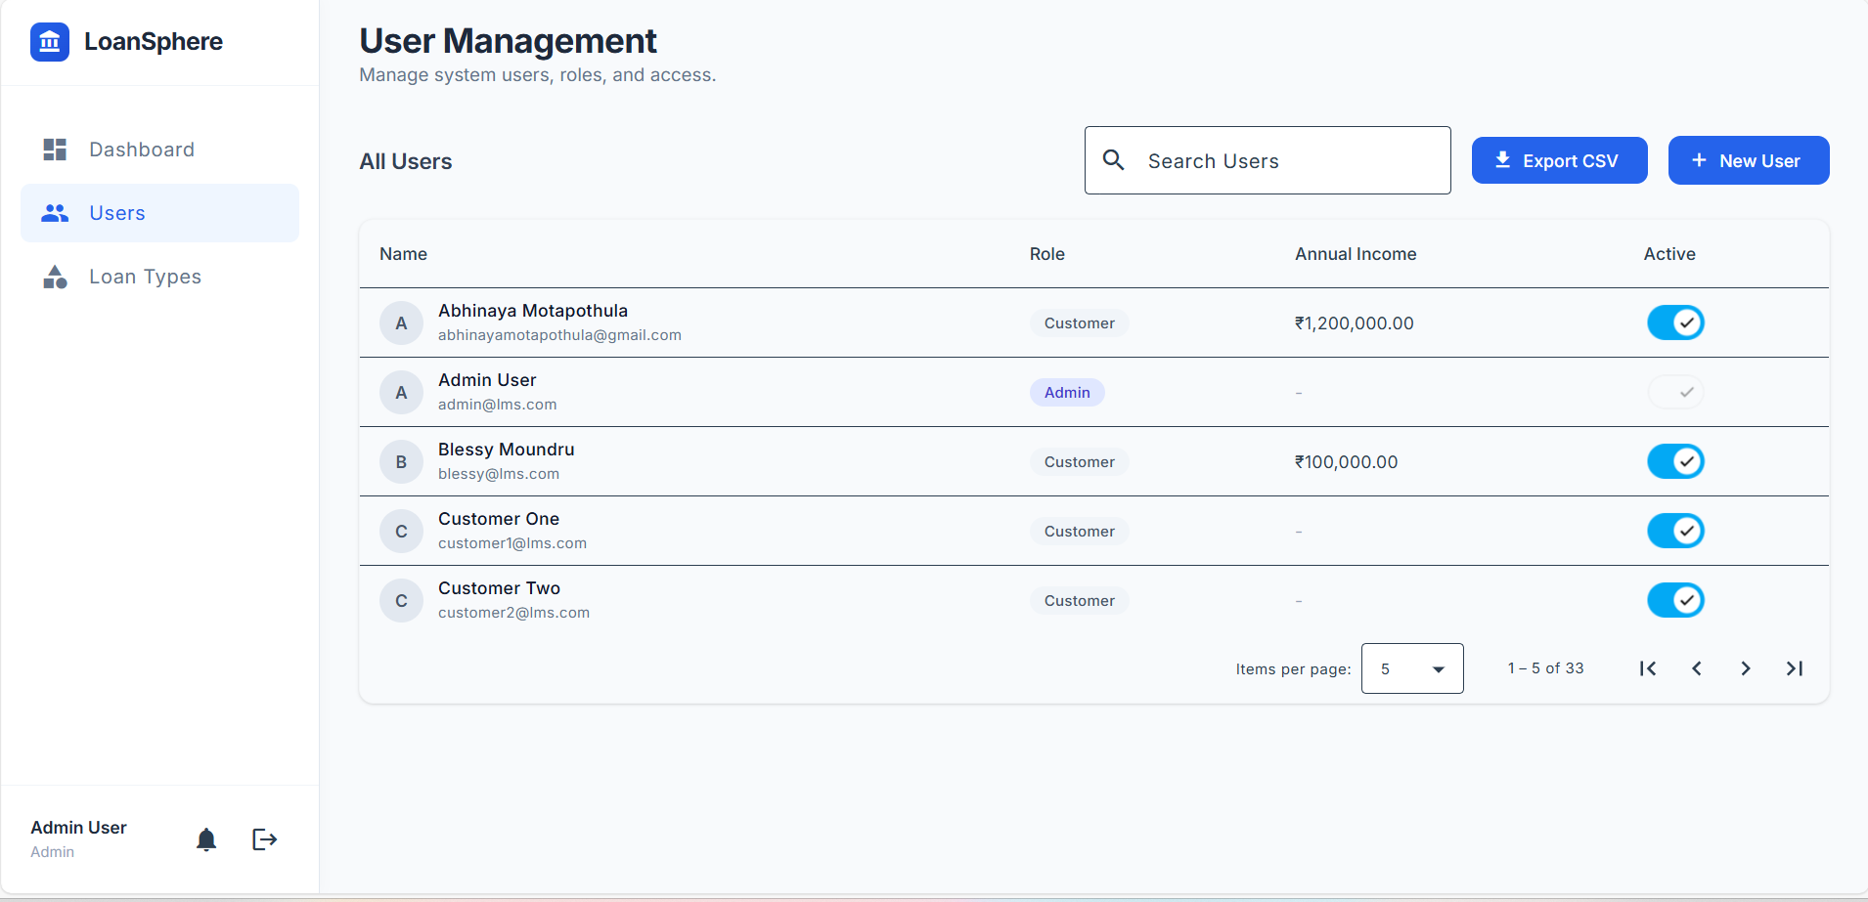
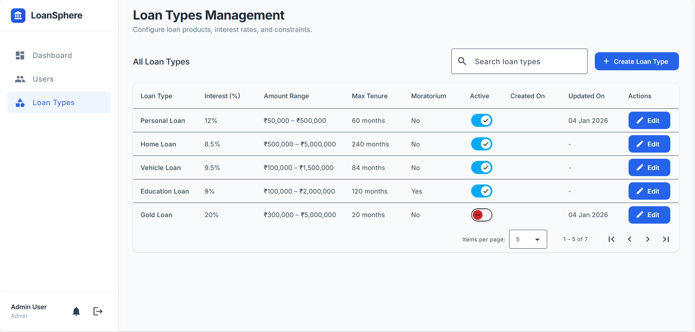
UI Screens
User Management
Loan Types Management

Slide 18
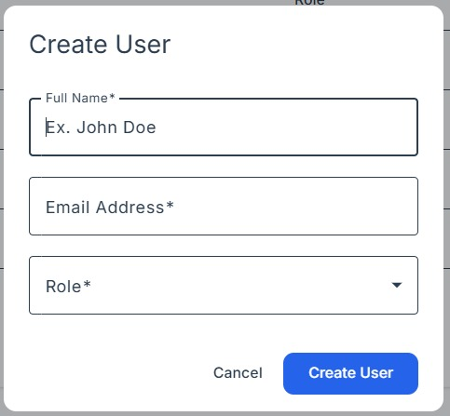
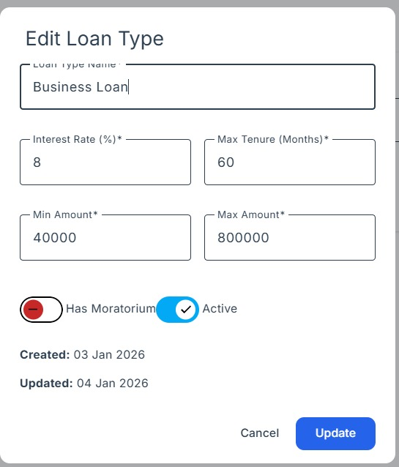
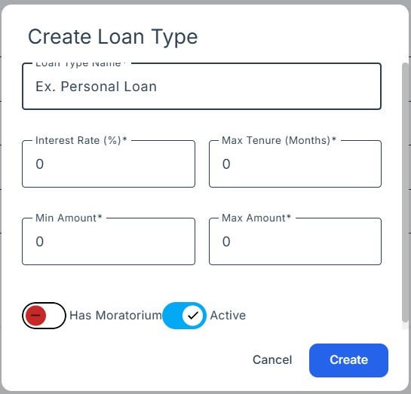
UI Screens
User & Loan Types Management

Slide 19
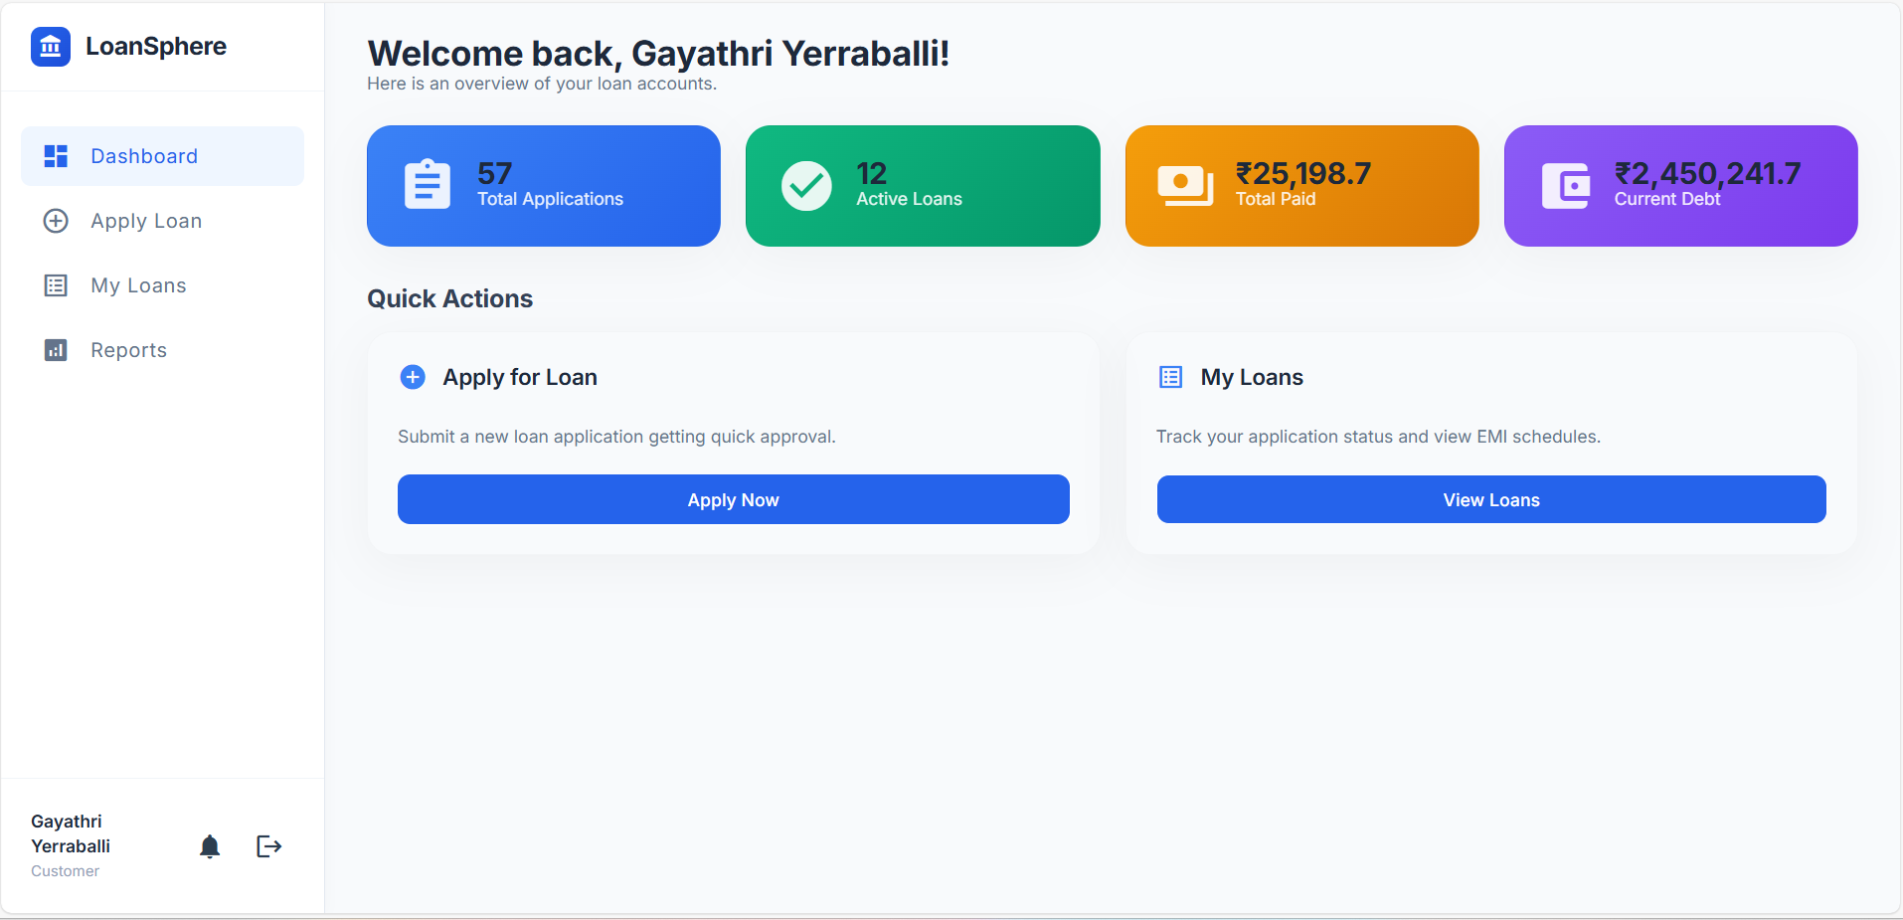
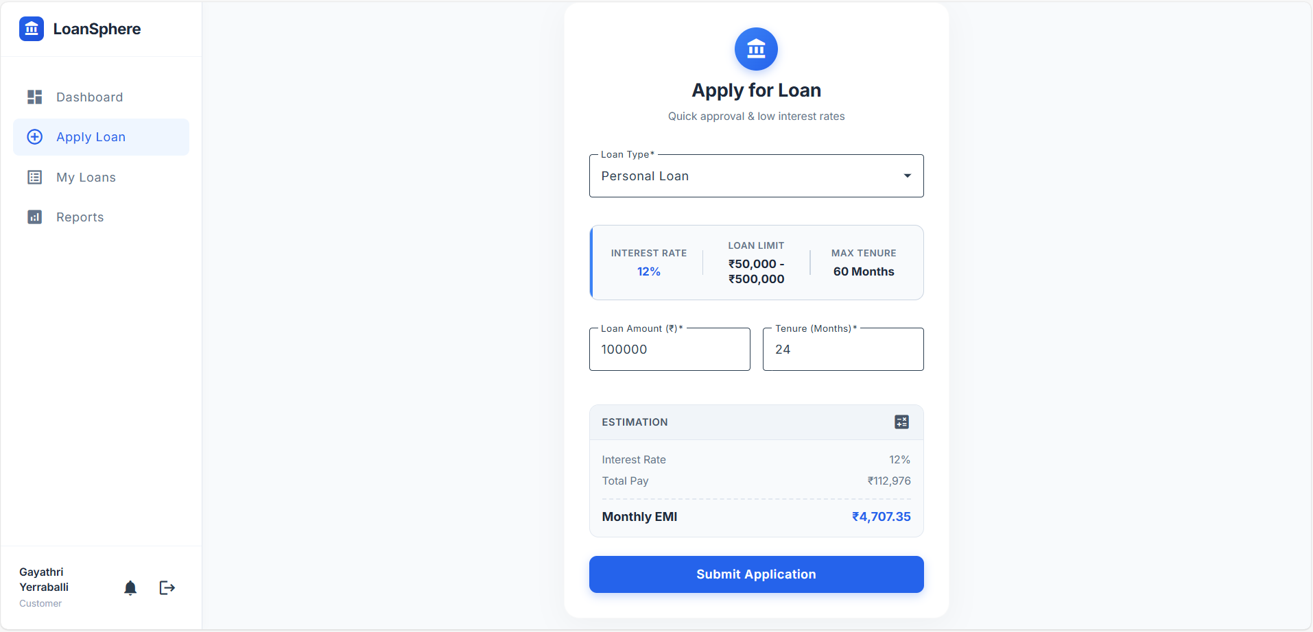
UI Screens
Customer Dashboard
Apply for Loan

Slide 20
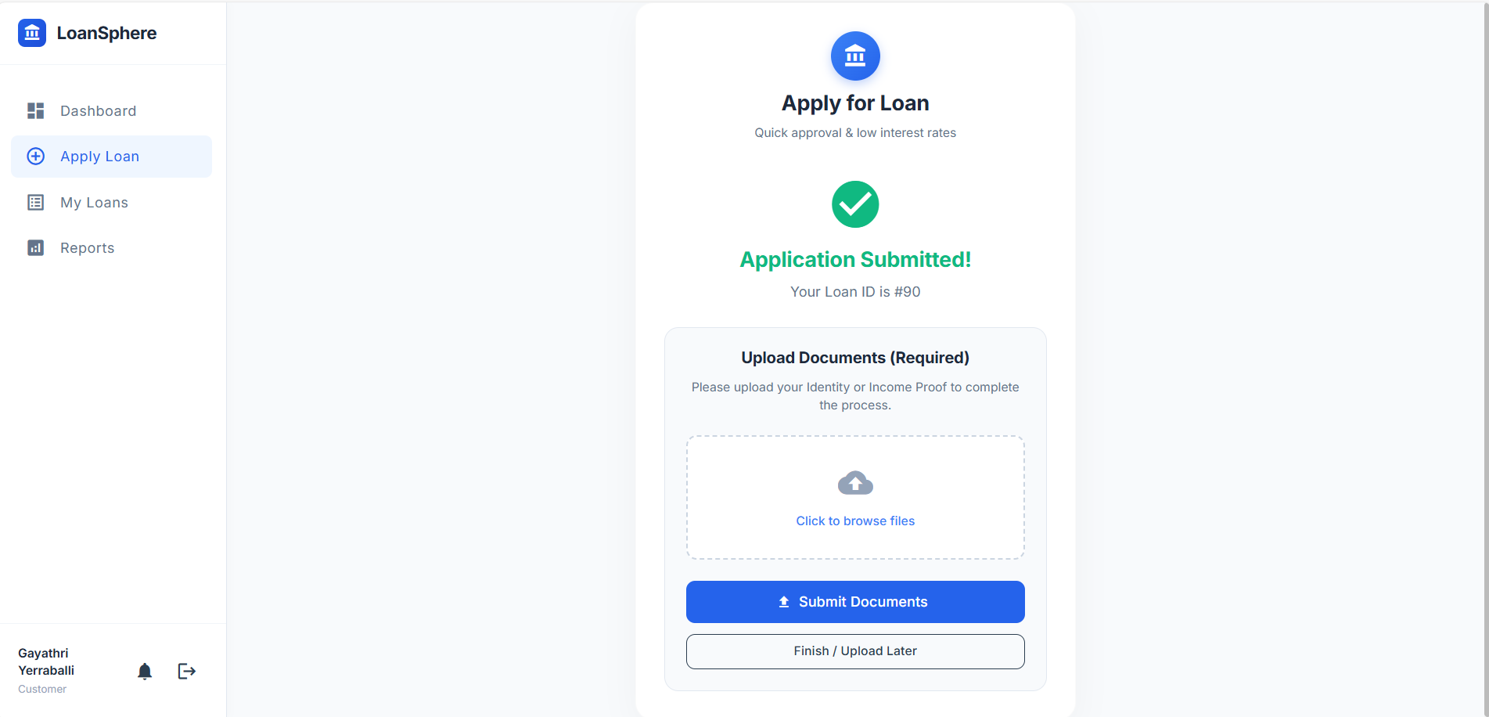
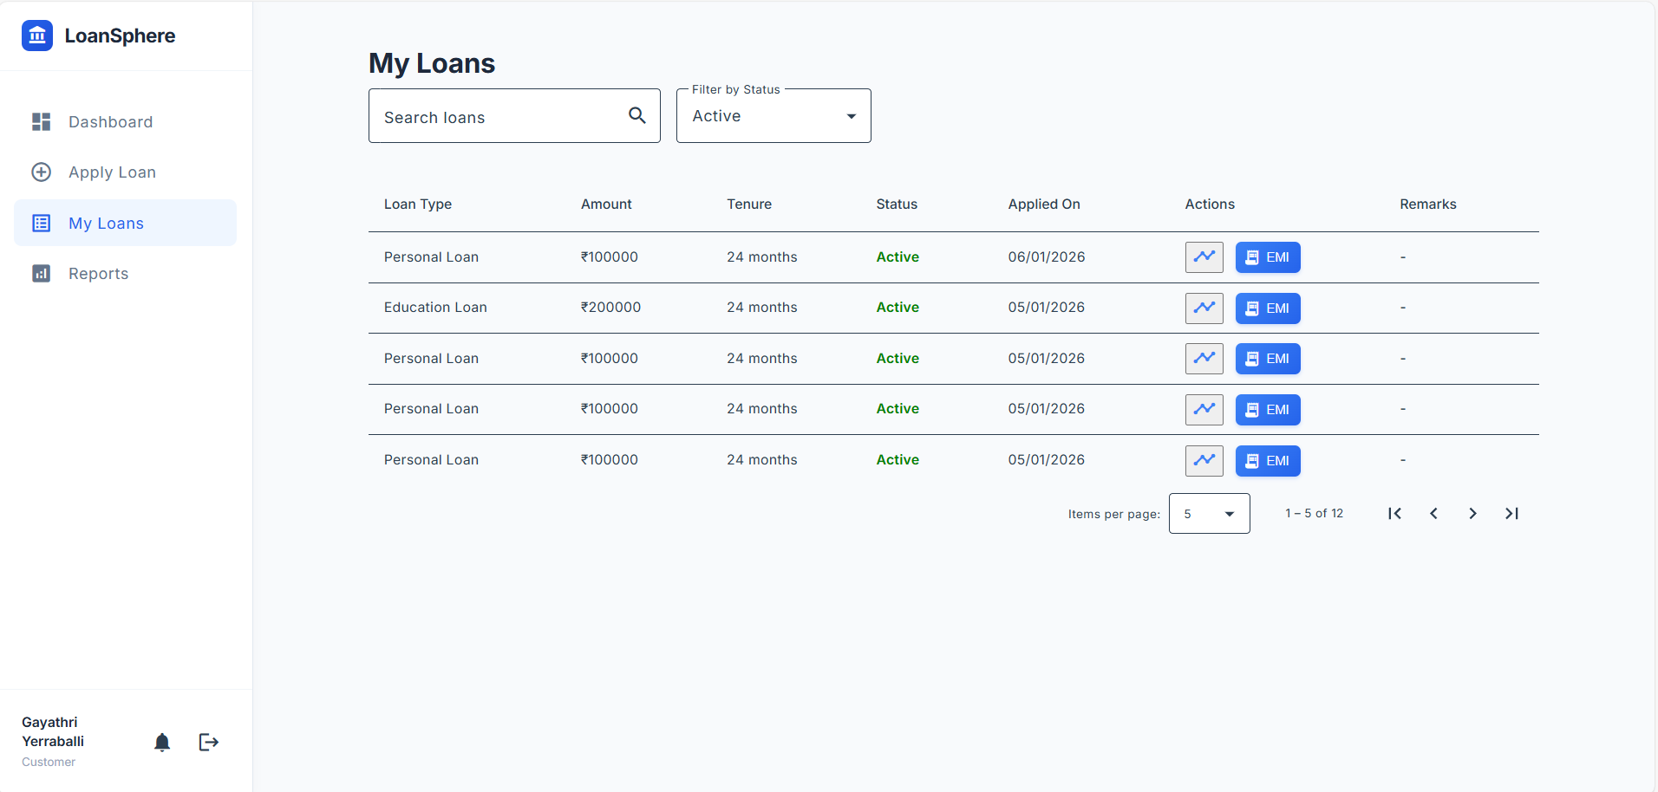
UI Screens
Proof Document Submission
My Loans

Slide 21
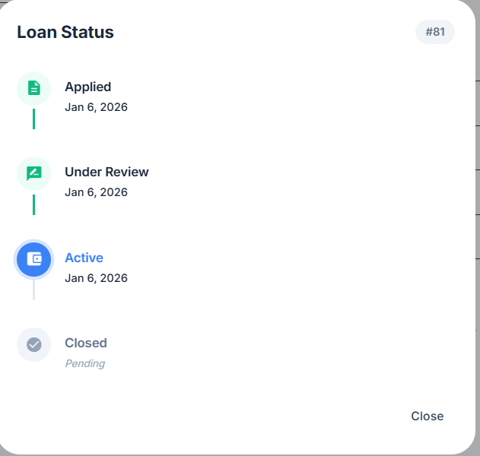
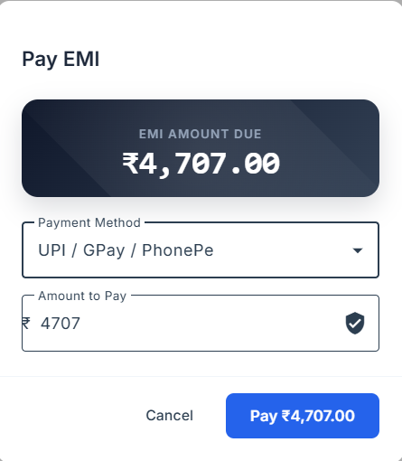
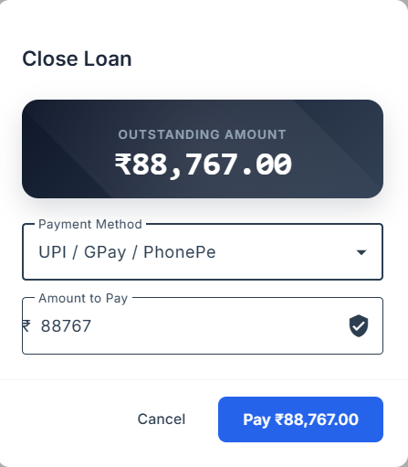
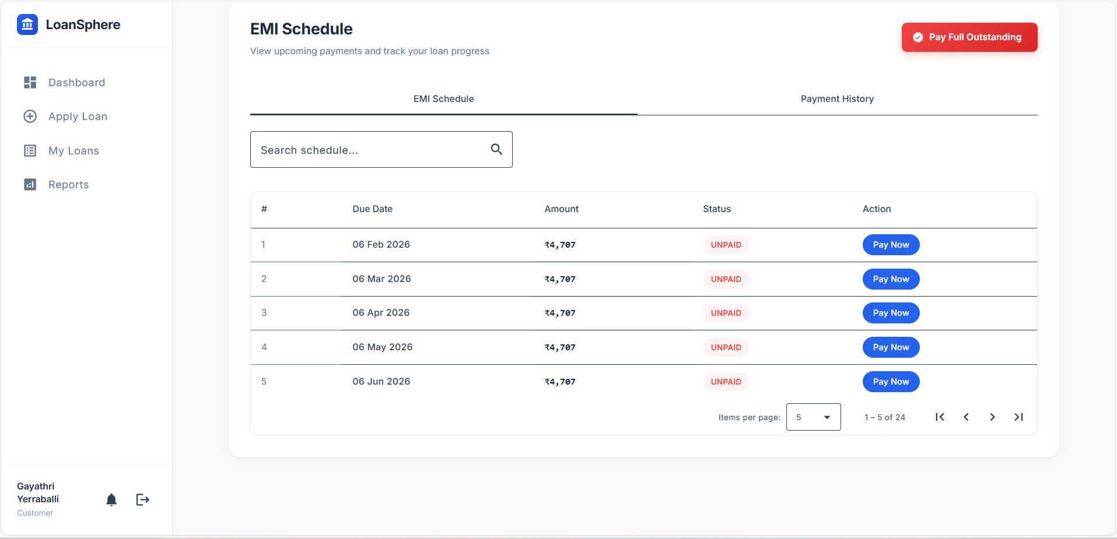
UI Screens
Loan Status,
EMI Schedule, Pay EMI,
Pay Outstanding

Slide 22
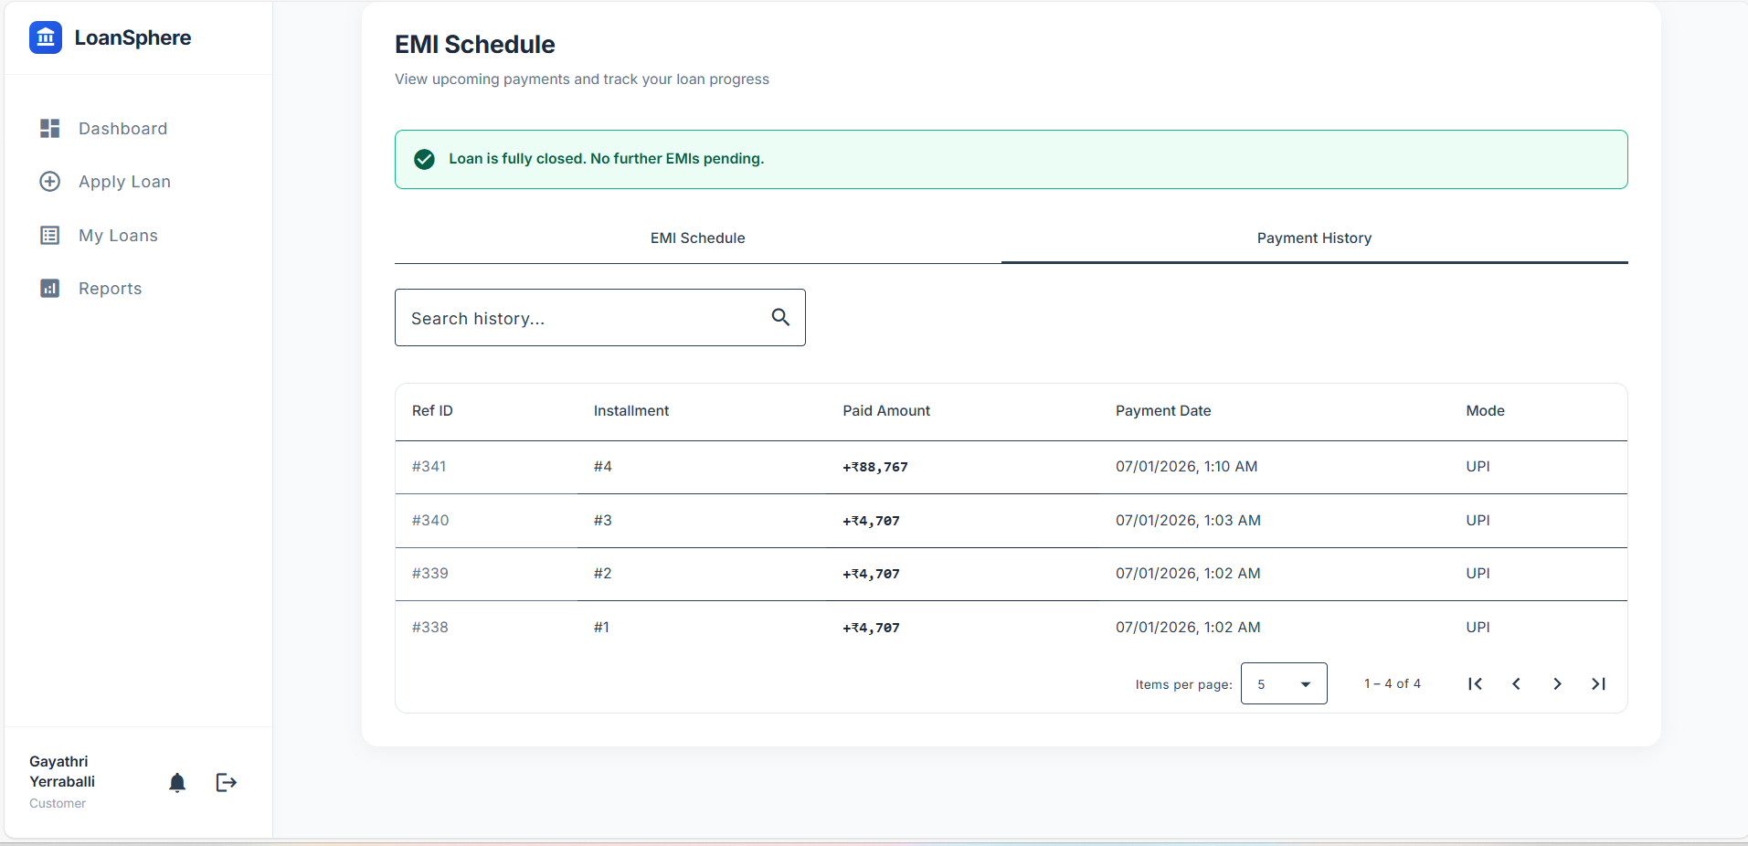
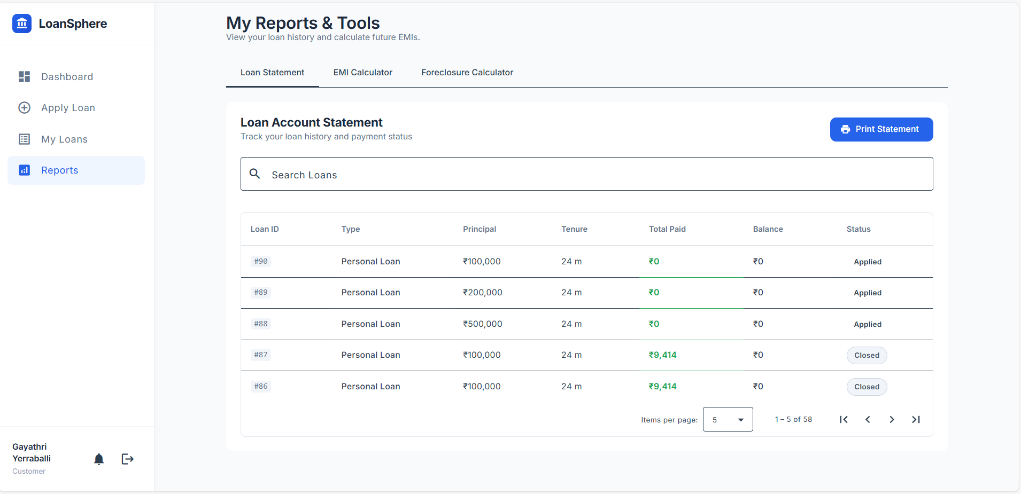
UI Screens
Payment History
Print Statement

Slide 23
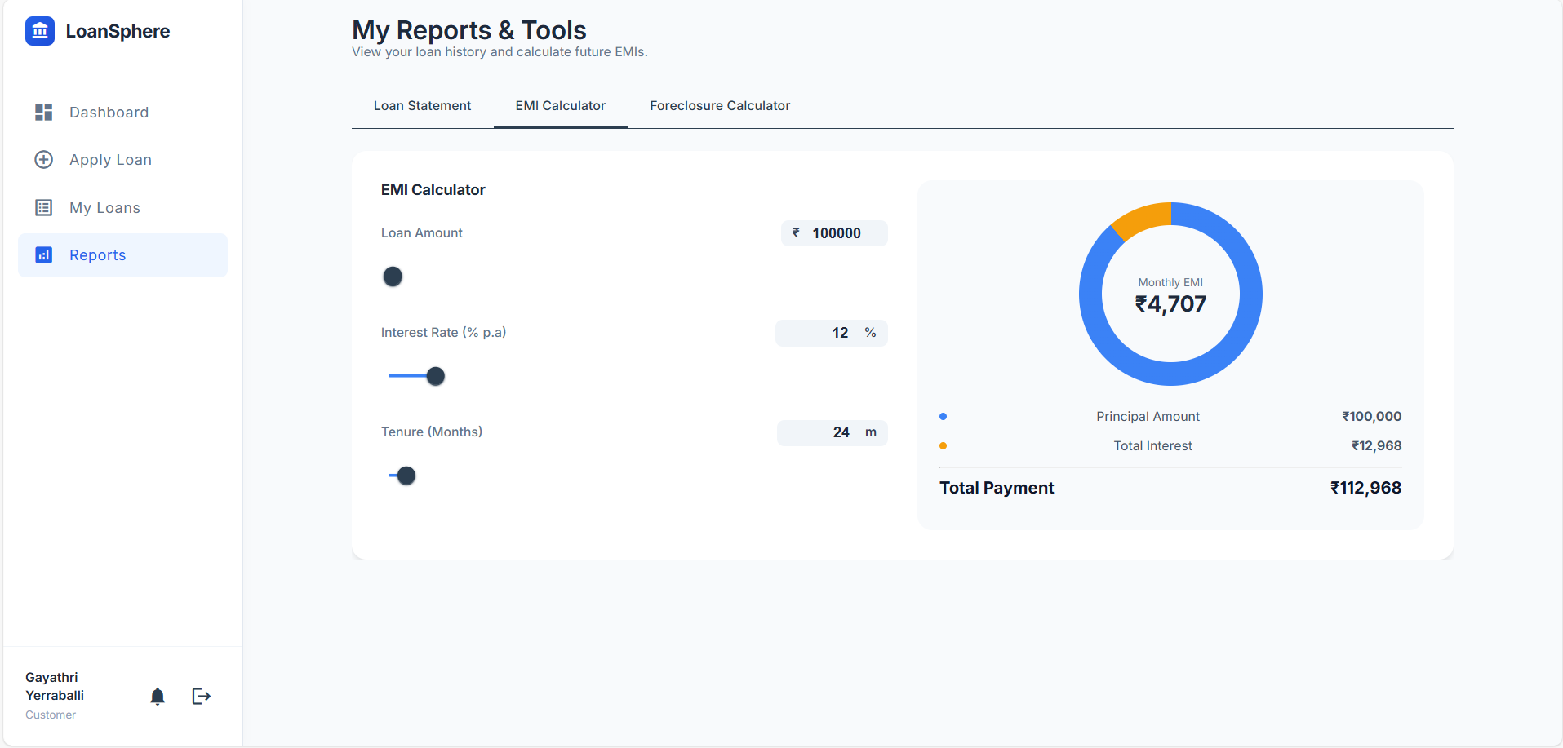
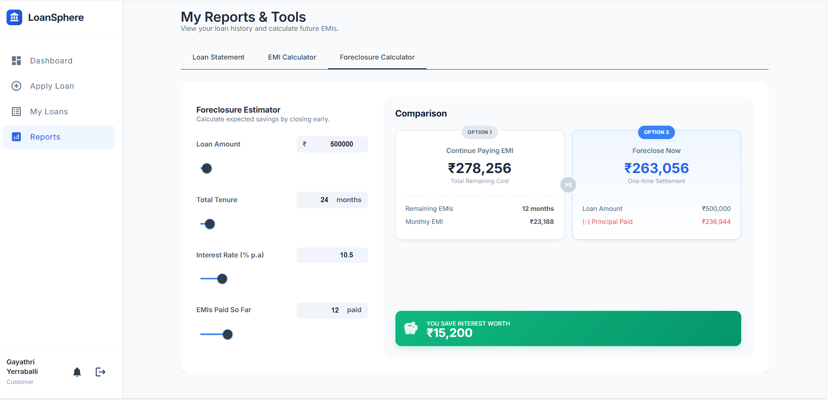
UI Screens
EMI Calculator
Foreclosure Calculator

Slide 24
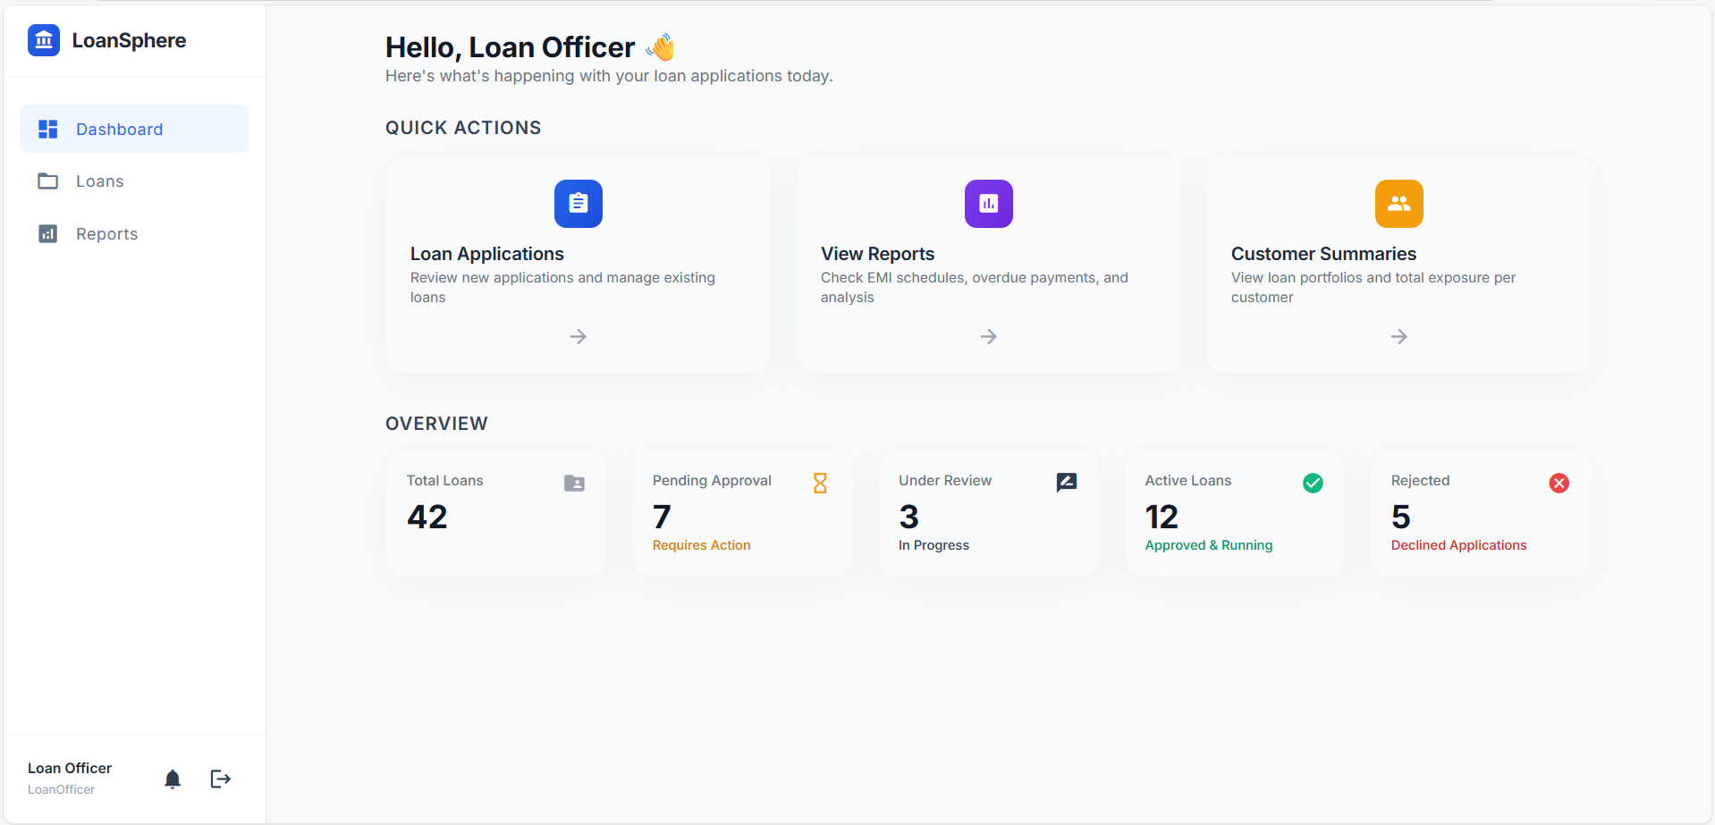
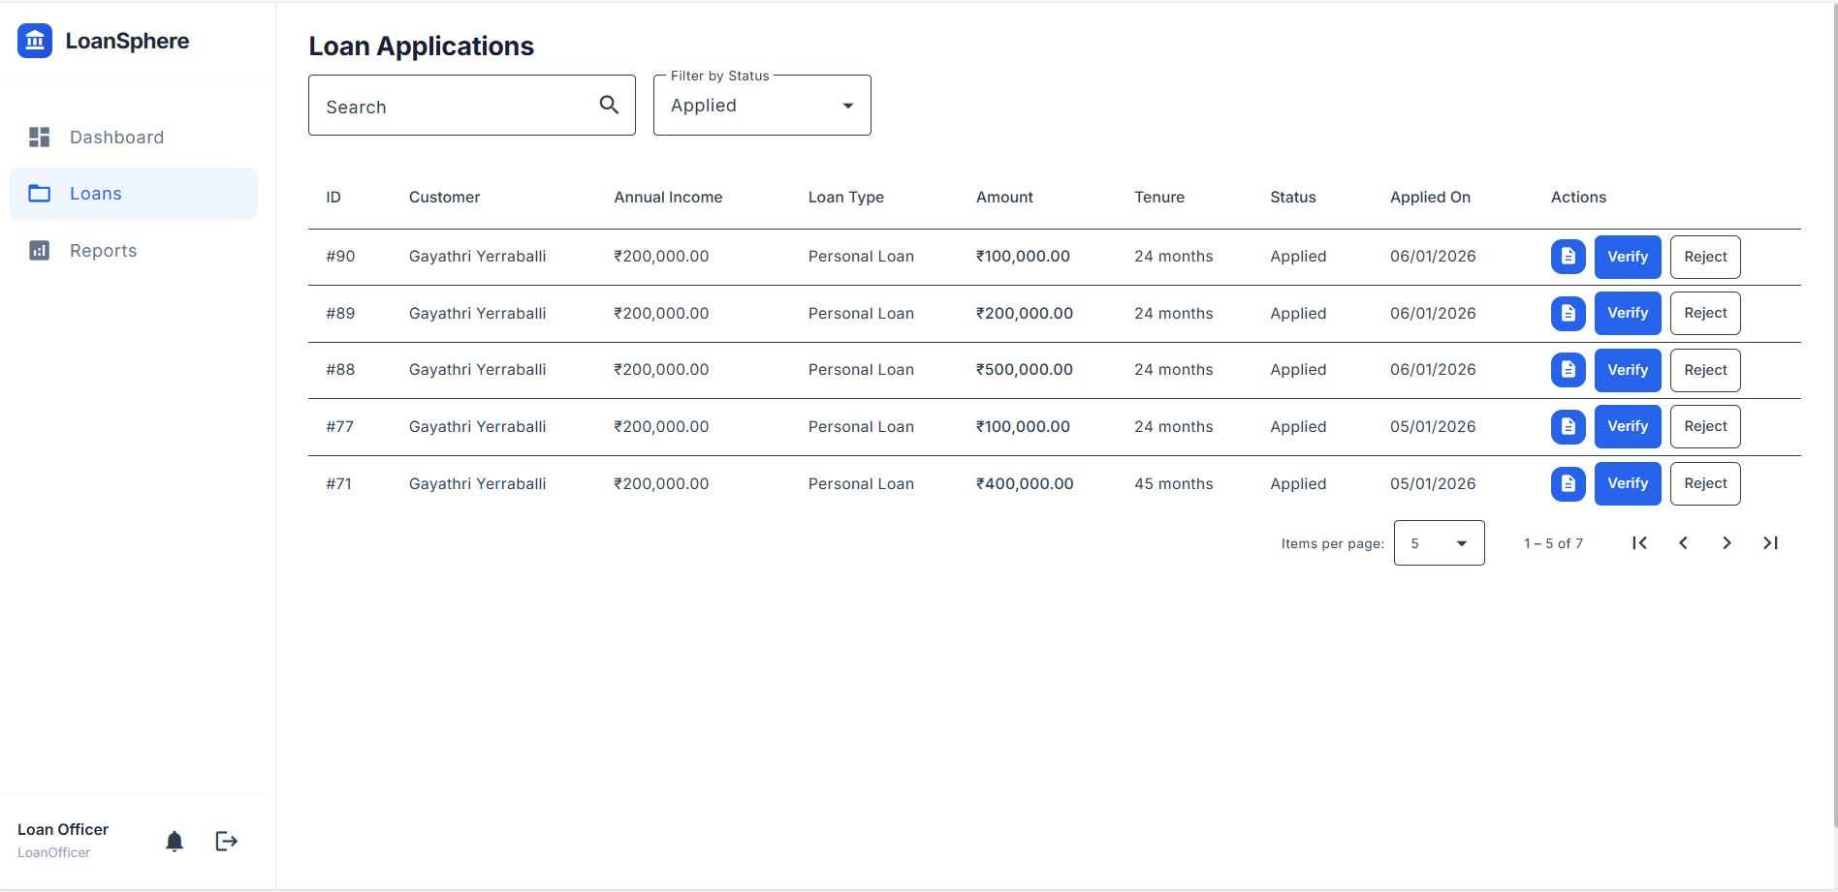
UI Screens
Loan Officer Dashboard
Loan Applications

Slide 25
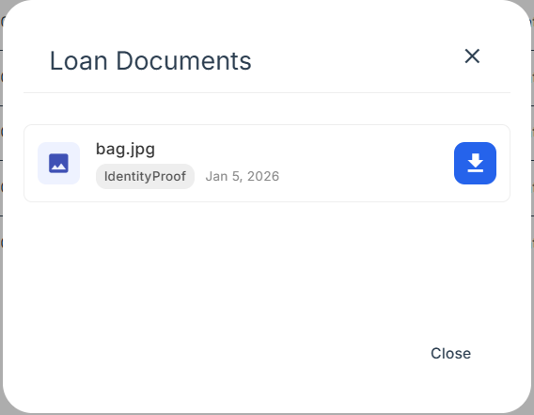
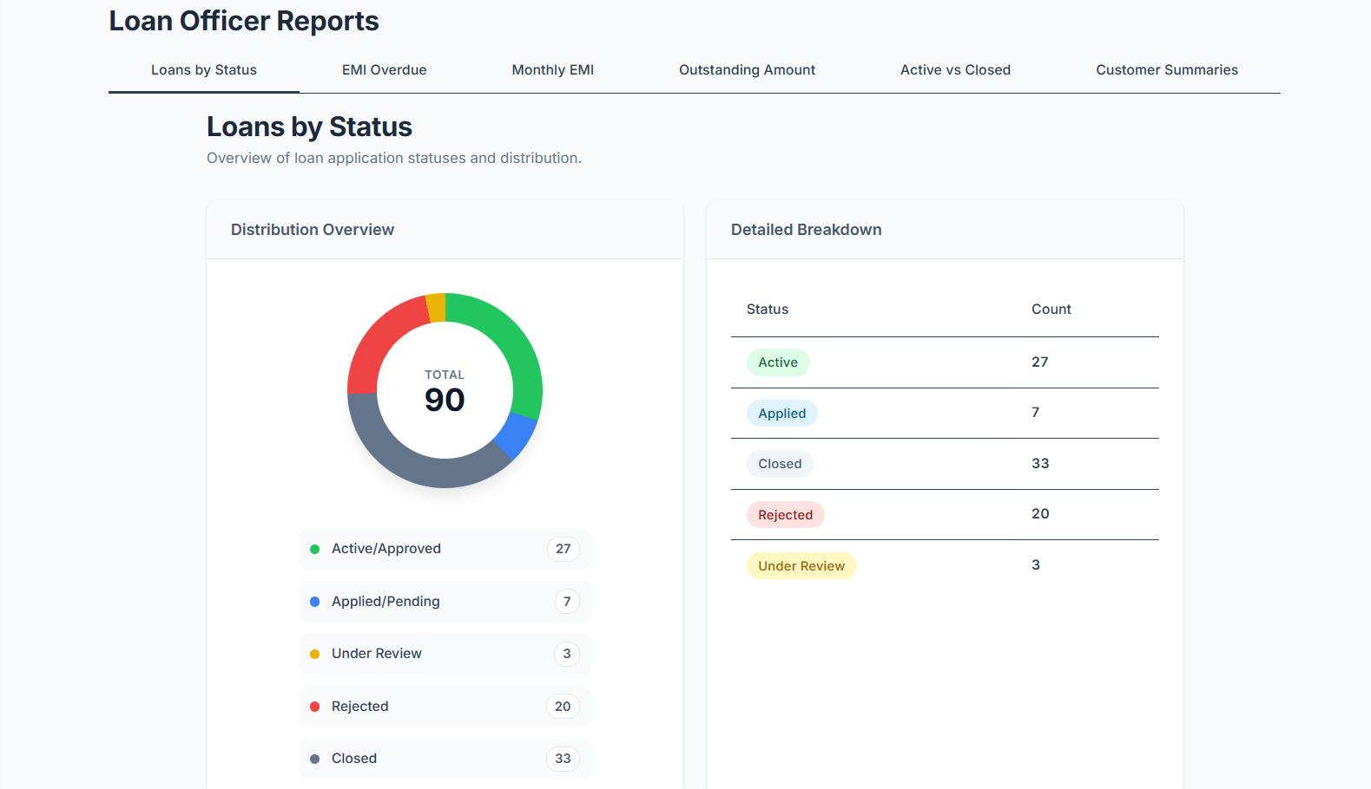
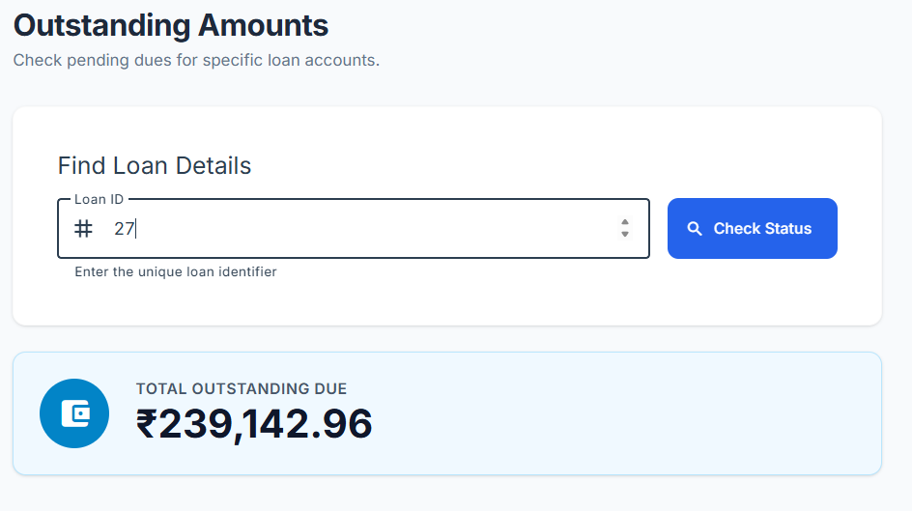
UI Screens
Loan Documents & Officer Reports

Slide 26
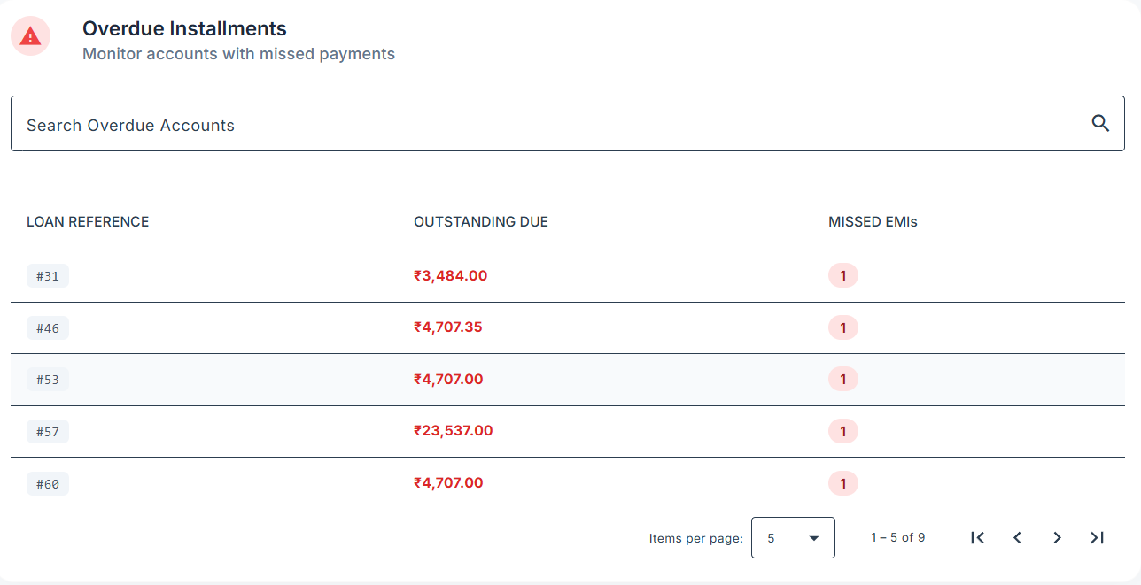
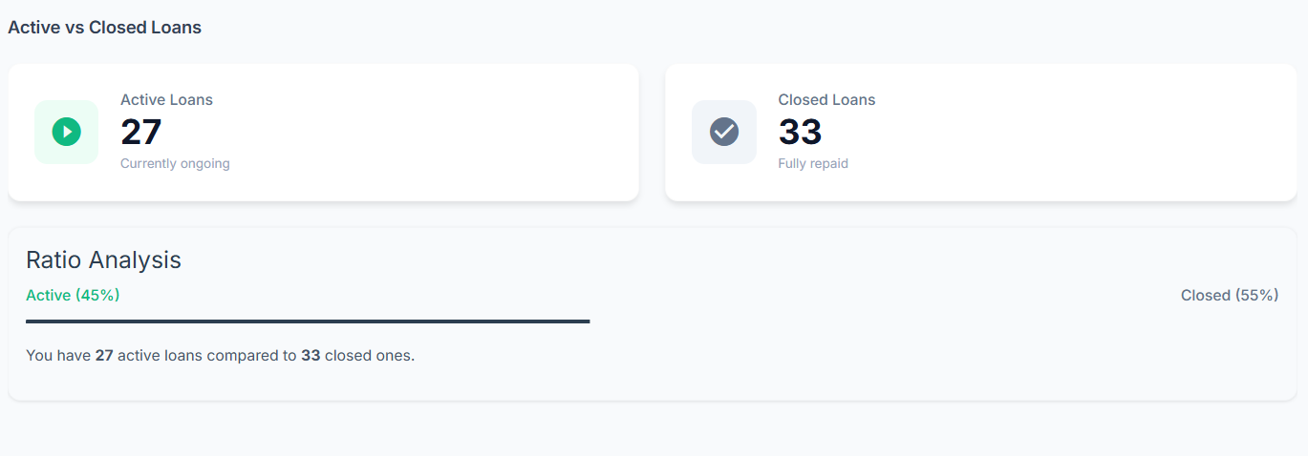
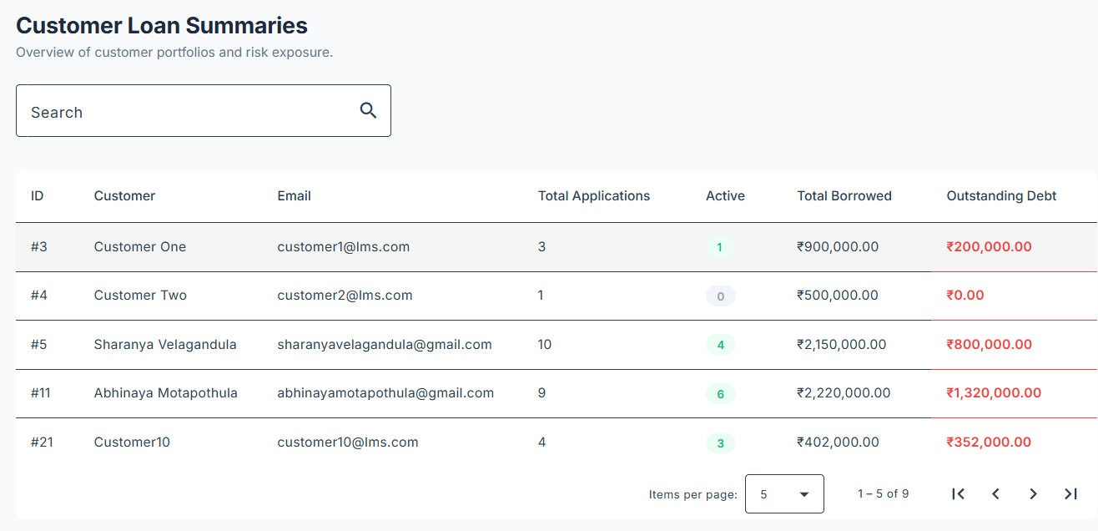
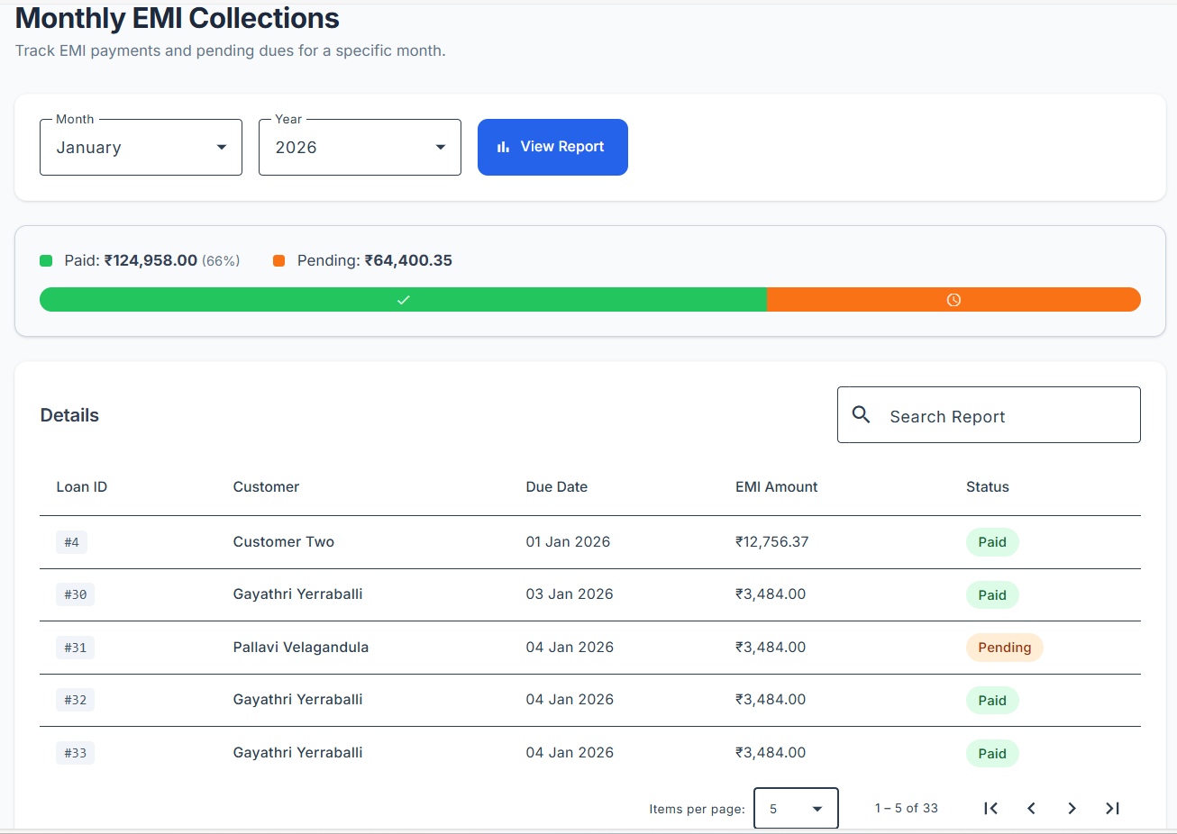
UI Screens
Reports

Slide 27
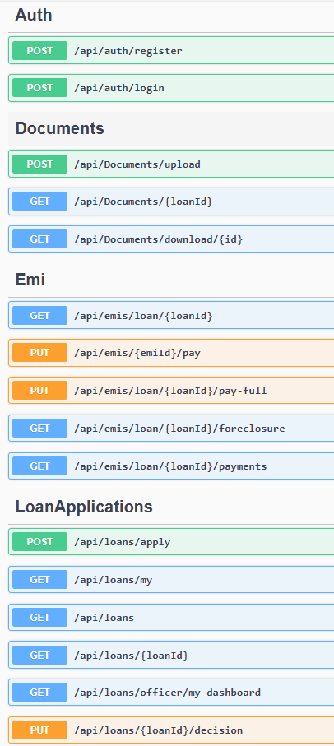
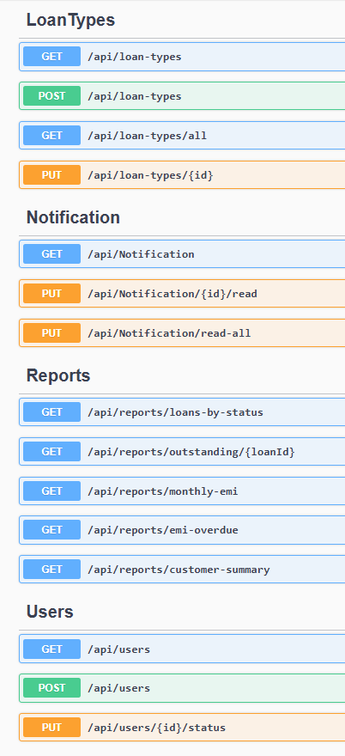
Swagger UI

Slide 28
Results & Achievements
Project Highlights
Real-World Rules: Implemented real-world logic vs basic CRUD.
Security: JWT, RBAC, and strict validations (Bcrypts).
Data Integrity: Robust backend validations ensure consistency.
Dashboards: Tailored views for Admin, Officer, and Customer.
Technical Wins & Outcomes
Streamlined Workflow: "Maker-Checker" separation of duties.
User Experience: Responsive, modern UI across devices.
Performance: Optimized LINQ and indexing.
Reliability: 100% data integrity with error handling.

Slide 29
Conclusion
LoanSphere is a secure foundation for real-world fintech.
Impact:
Reduces processing time by 70%, increases transparency by 100%.
Thank You

Slide 30
Live Demo
Showcasing LoanSphere in Action

